Slide 1
Custom Frequencies
Joe & Jon

Slide 2
Introduction
Requirements
MPY32 (Assembly), LCD, Keypad, low power mode
Approach
Solutions
Revisions
Challenges

Slide 3
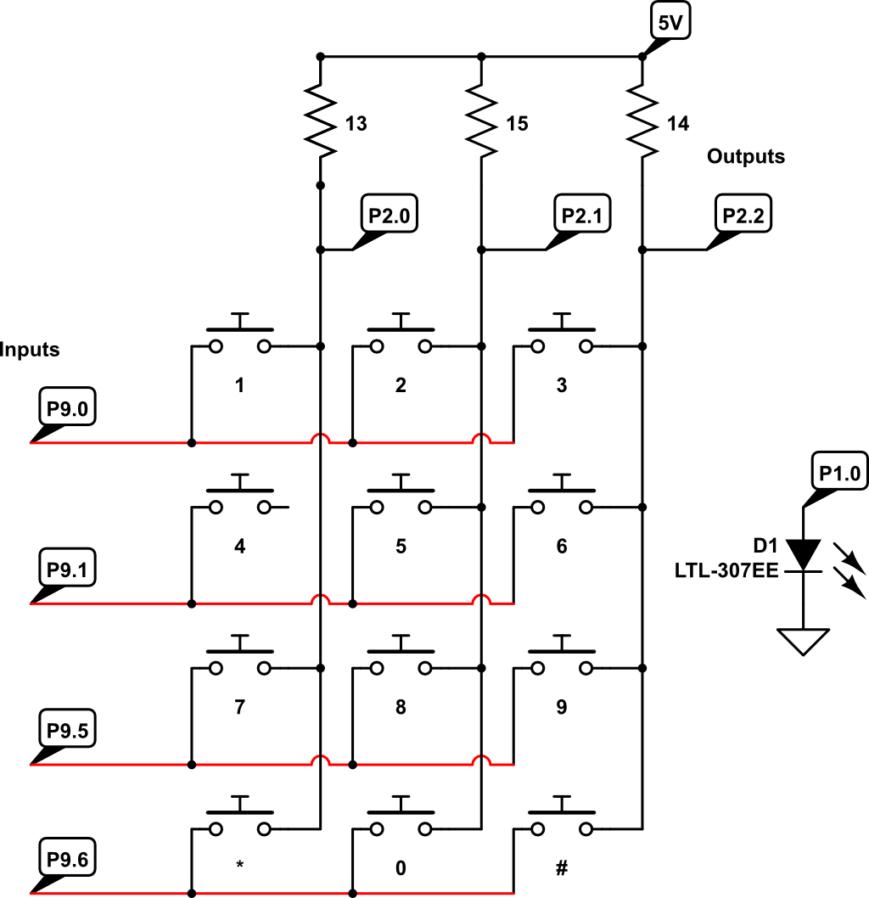
Circuit
8 IO pins used
5 digital outputs
3 digital inputs

Slide 4
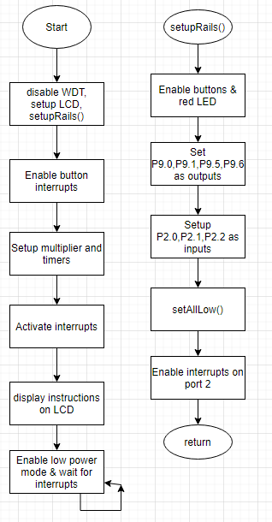
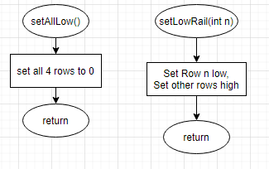
Process/Flowcharts

Slide 5
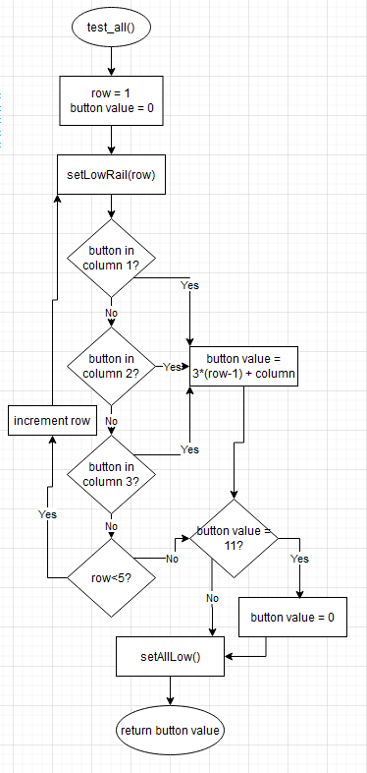
Which Button?

Slide 6
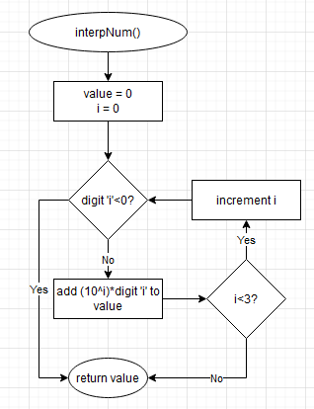
Frequency Value

Slide 7
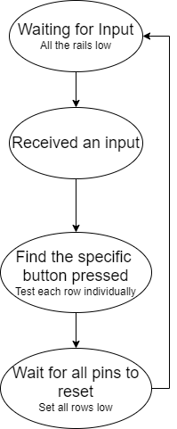
Keypad
Ports 2(3 pins) & 9(4 pins)
When not in use all pins are held low.
If multiple buttons are pressed only the first item is recorded.

Slide 8
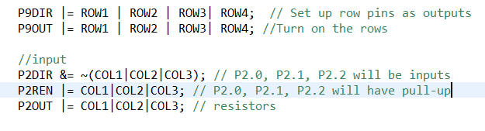
LCD & Pin Adjustments
Plan A: Ports 3 & 9
Plan B: Ports 2 & 9
LCD documentation does not mention these pins

Slide 9
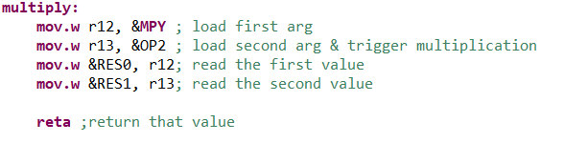
Assembly & Multiplier
Multiply 2 16-bit numbers
Output is a 32-bit number
C code:
Assembly code:

Slide 10
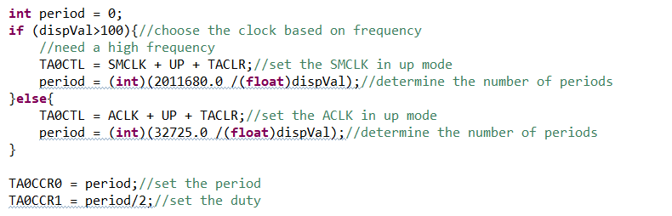
Timers & PWM
Lots of small adjustments

Slide 11
Extra Features
Only one button activates at once
Backspace = *
Enter = #
On board buttons for redundancy
Exit instructions

Slide 12
Challenges
Familiarity with assembly/C connection
LCD stealing pins
Efficiency of functions
How to prevent multiple button presses

Slide 13
Questions?

